Slide 1
Meeting with the monitoring committee
2nd year
Université de Bordeaux
Ecole doctorale Mathématiques et Informatique
Talence, 19 July 2018

Slide 2
Subject
Supervisor: Marie BEURTON-AIMAR
“Extraction automatique de caractéristiques
morphologiques des espèces pour la classification
d'insectes: application aux ravageurs de culture et
espèces invasives”

Slide 3
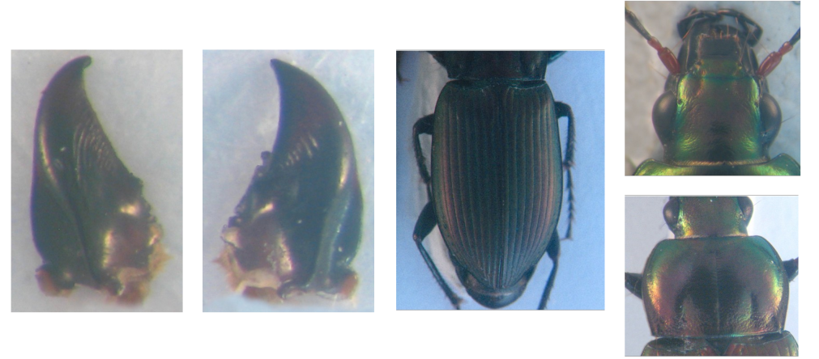
Dataset
Color images (2D) of 293 beetles (3264x2448)
Five images by insect: head, thorax, elytra, left and right mandible

Slide 4
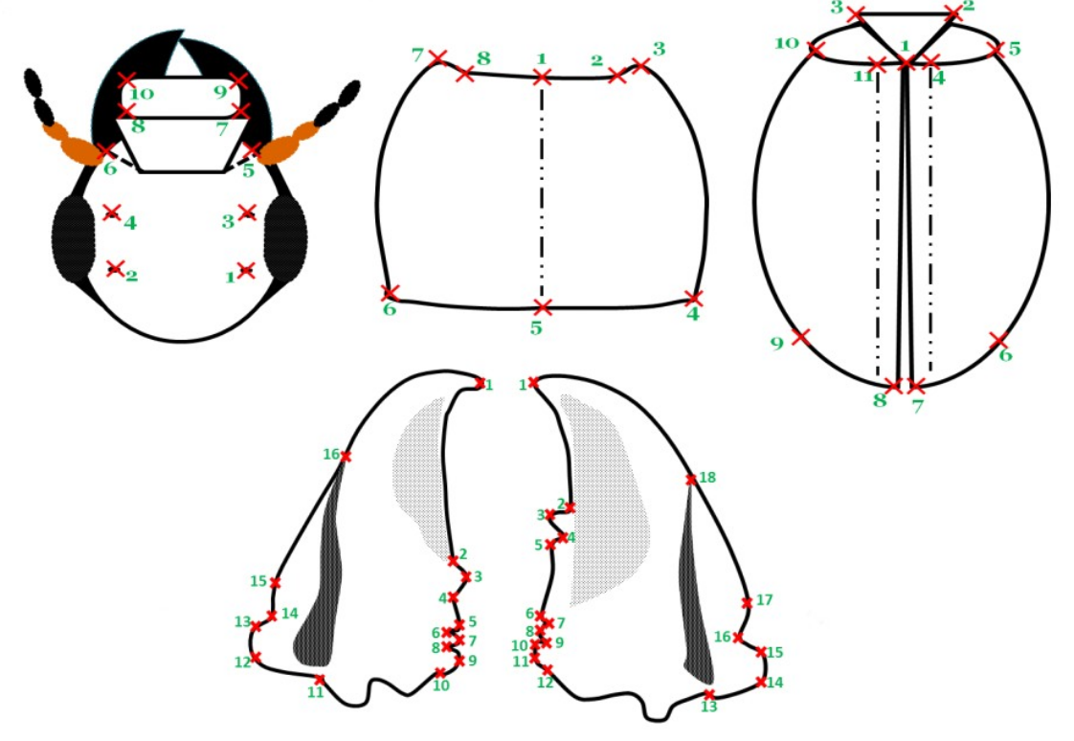
Objective of the thesis

Slide 5
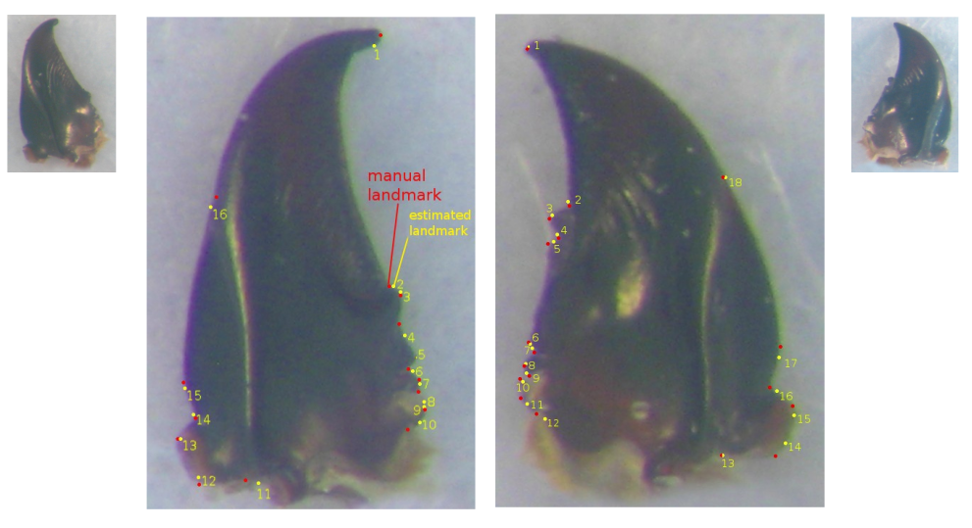
Status of the thesis: the 1st year

Slide 6
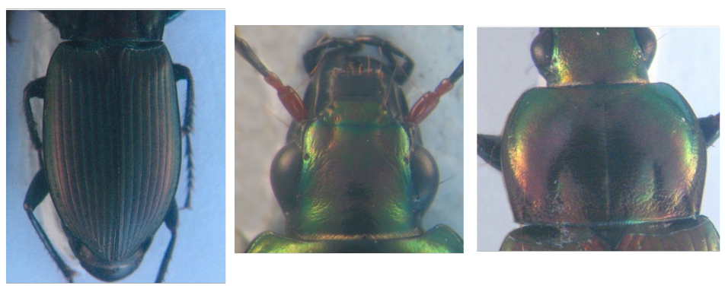
Status of the thesis: the 2nd year
Applying Deep Learning

Slide 7
Status of the thesis: the 2nd year
Down
sampling
images
Augment
dataset
Design
Network
Train
Network
Test
Network

Slide 8
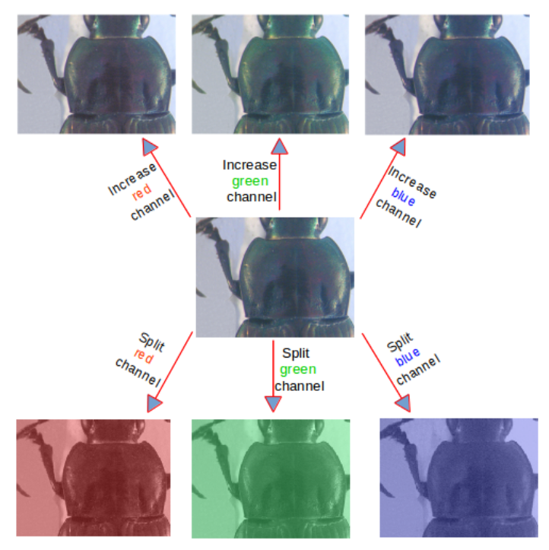
Dataset augmentation

Slide 9
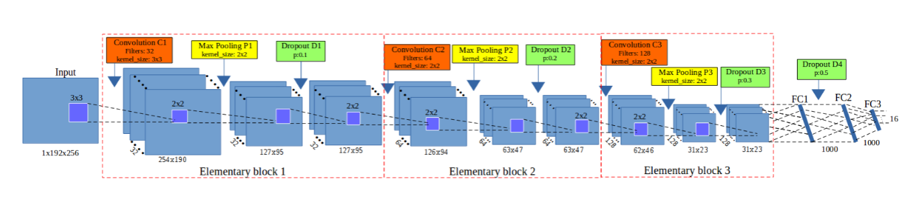
Network architecture

Slide 10
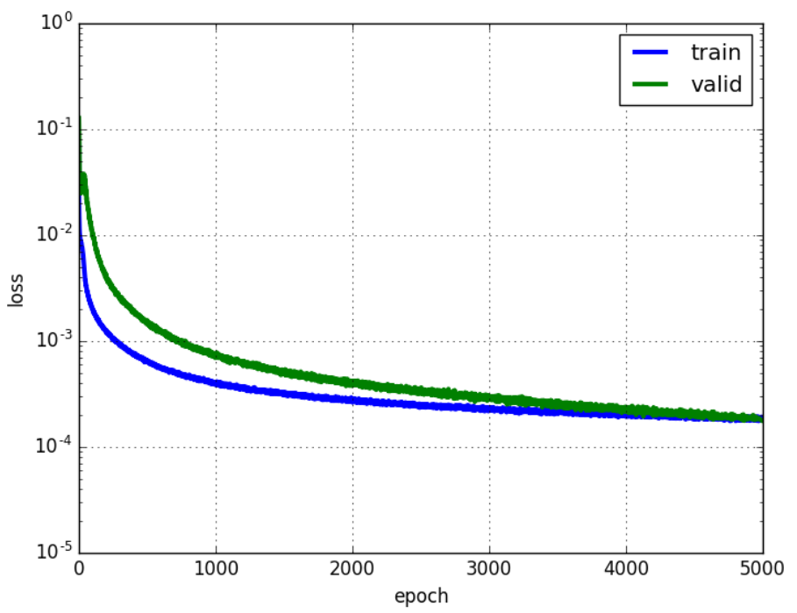
Training stage
Training dataset: 1 820 images (260 x 7)
Testing dataset: 33 images
Apply the cross-validation to select training data

Slide 11
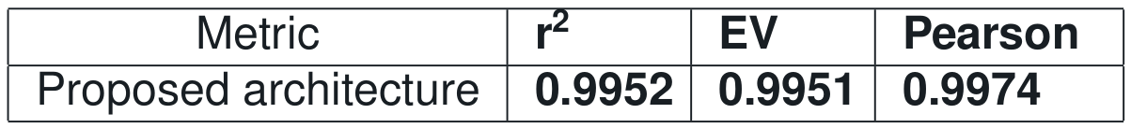
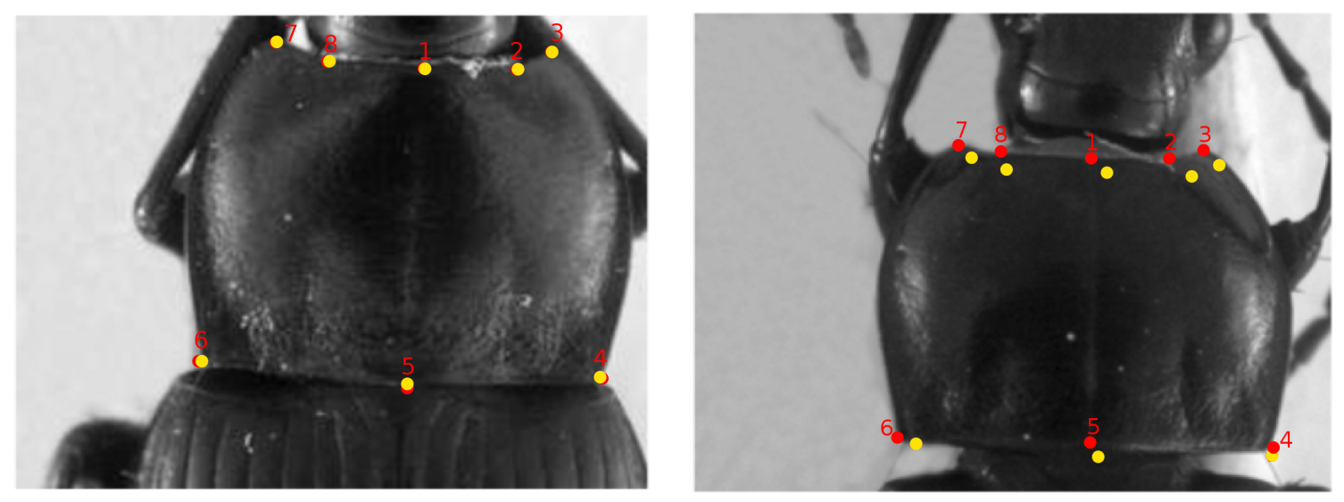
Results
Quality metrics
Display on images

Slide 12
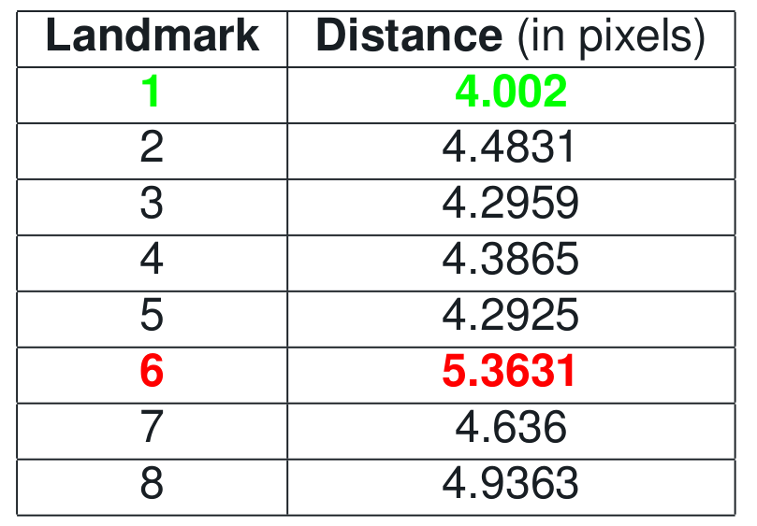
Results

Slide 13
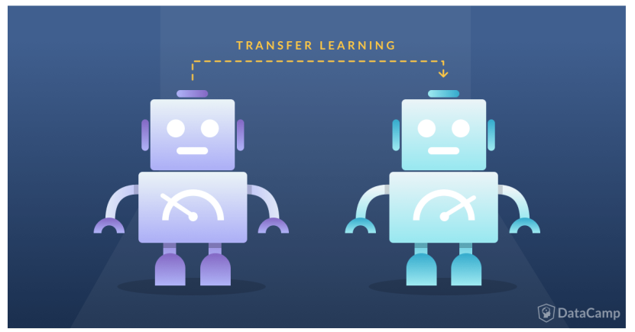
Improving the results

Slide 14
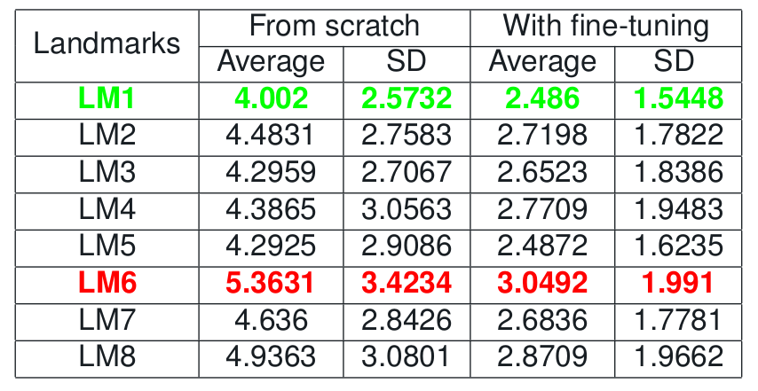
Improving the results

Slide 15
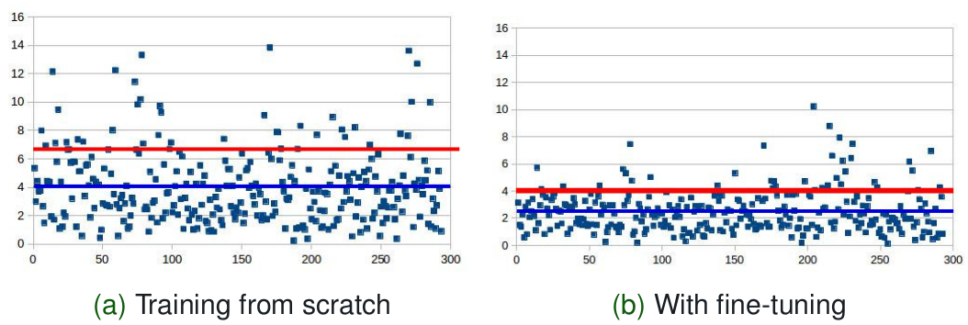
Improving the results
The distribution of distance of the best result: 1st landmark

Slide 16
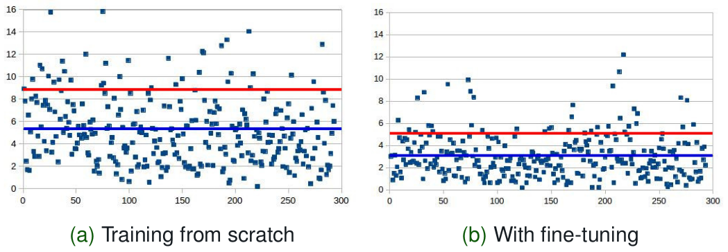
Improving the results
The distribution of distance of the worst result: 6th landmark

Slide 17
Future works
Continue improving the coordinates of predicted landmarks
Going deeply how to design the right pre-training model.

Slide 18
Training courses attended
Introduction to Deep Learning
Les temps modernes de l’Intelligence Artificielle
Scientific Python (beginner + advanced)
Deep Learning – Teledetection et Temps
Summer school: Deep Learning (23/07 - 27/07)

Slide 19
Thank you

